Slide 1

📦 Logistics Optimisation for Delivery Routes –
SQL Analytics Project
Name: Nischith C G Date : December 2025
Tools used : SQL Workbench
Project Video Link:

Slide 2

TABLE OF CONTENTS
Task 1 – Data Cleaning
Task 2 – Delay Analysis
Task 3 – Transit Efficiency
Task 4 – Warehouse Analysis
Task 5 – Agent Performance
Task 6 – Shipment Tracking
Task 7 – KPI Reporting
Task 8 – Final Recommendations

Slide 3
Dataset Summary
Table Name | Key Columns | Purpose
Orders | Order_ID, Customer_ID, Order_Date, Route_ID, Warehouse_ID | Tracks customer orders and assigned routes/warehouses
Routes | Route_ID, Source/Destination City, Distance_KM, Avg_Transit_Time | Provides route-level transportation details
Warehouses | Warehouse_ID, City, Country, Capacity_per_day | Information about FedEx hubs and their daily capacity
Delivery Agents | Agent_ID, Agent_Name, Zone, Experience_Years, Avg_Rating | Delivery personnel details + performance attributes
Shipments | Shipment_ID, Order_ID, Agent_ID, Pickup/Delivery_Date, Delay_Hours, Status | Core shipment tracking, delays, and final outcomes

Slide 4
Project Overview
FedEx operates a large global logistics network connecting 220+ countries through major hubs like Memphis, Dubai, Shanghai, Singapore, and London.
This project applies SQL-based analytics to evaluate and optimise logistics performance across routes, warehouses, and delivery agents.
The project aims to:
● Identify delay patterns and operational inefficiencies.
● Optimise hub and route combinations for improved transit times.
● Analyse agent- and warehouse-level performance.

Slide 5
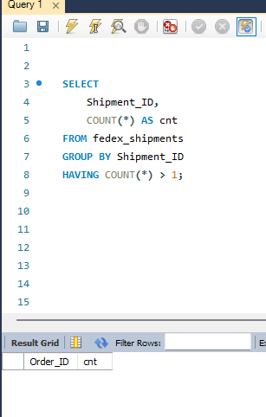
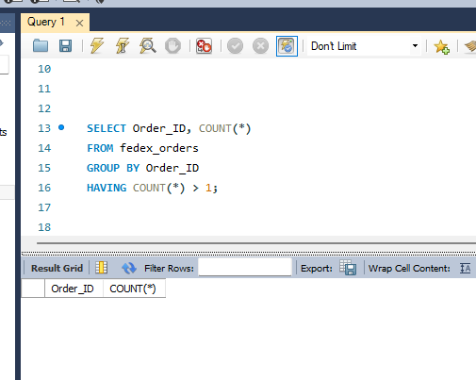
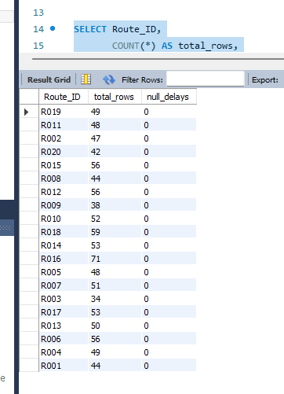
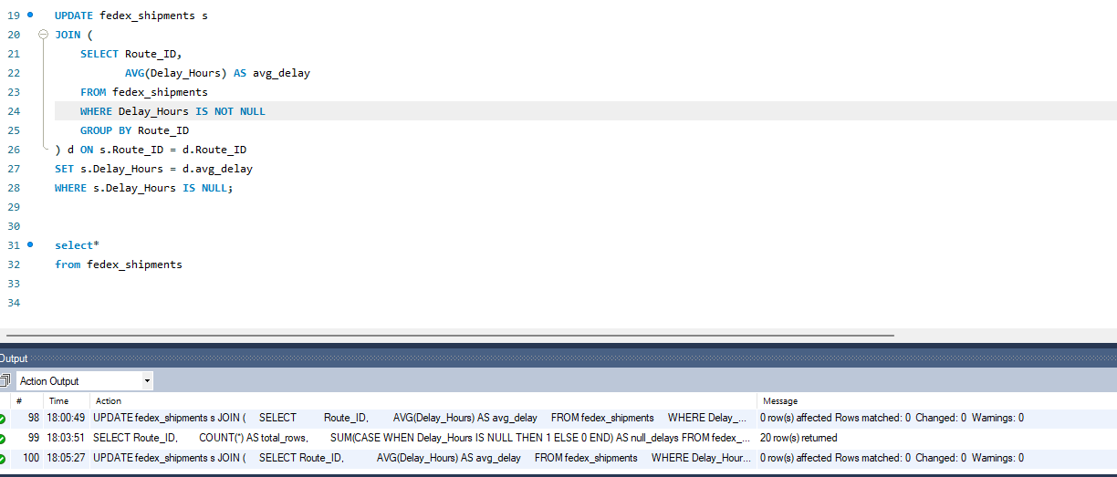
Task 1 — Data Cleaning & Preparation
1. Identify and delete duplicate Order_ID or Shipment_ID records.
2. Replace NULL Delay_Hours with Average Delay per Route_ID
Shipment table
Order table
✔ No duplicates found in Orders or Shipments.
All NULL Delay_Hours replaced with corresponding Route_ID average.

Slide 6
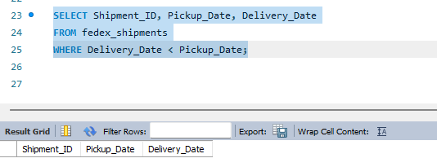
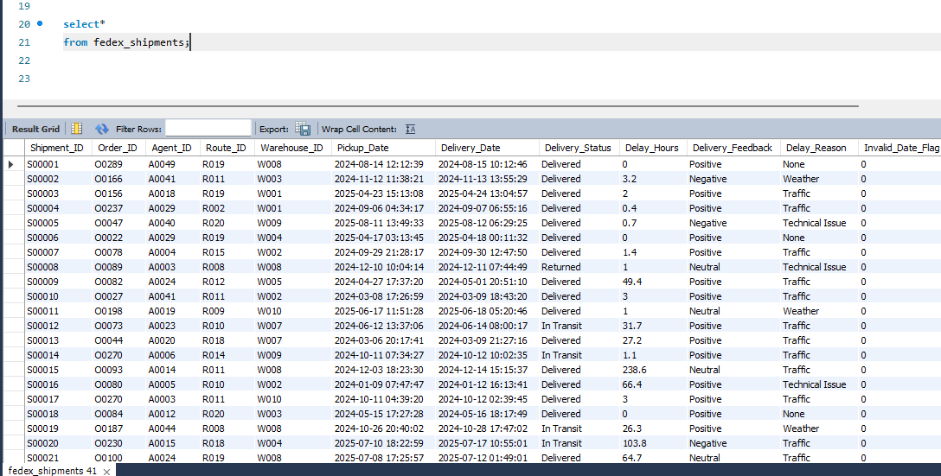
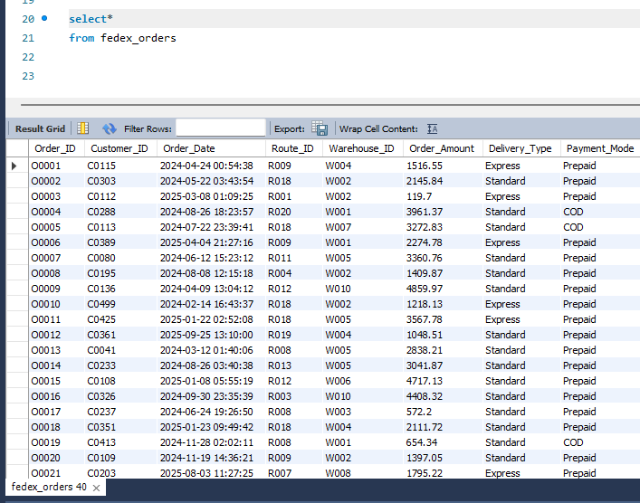
Task 1 — Data Cleaning & Preparation
3. Convert All Date Columns to YYYY-MM-DD HH:MM:SS Format
4. Ensure No Delivery_Date Occurs Before Pickup_Date
Formula used
ALTER TABLE fedex_ordersMODIFY COLUMN Order_Date DATETIME;
ALTER TABLE fedex_shipments
MODIFY COLUMN Pickup_Date DATETIME,
MODIFY COLUMN Delivery_Date DATETIME;
Shipment table
Order table
✔ All date fields were already stored in proper DATETIME format.
✔ Changed columns to DATETIME type. ✔ No formatting issues found.
✔ Checked for invalid delivery timestamps
✔ No invalid delivery records found (based on your empty screenshot). ✔ All Delivery_Date ≥ Pickup_Date.

Slide 7
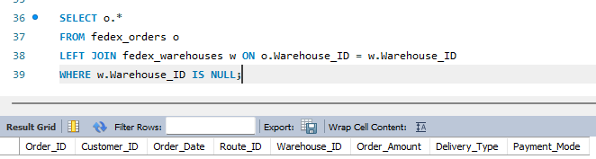
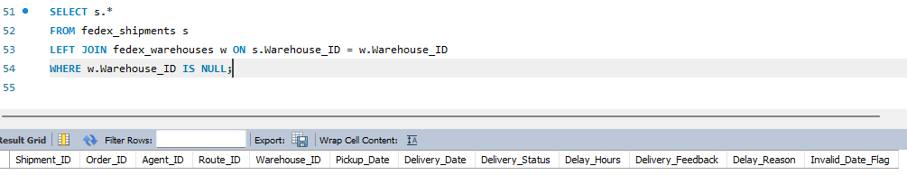
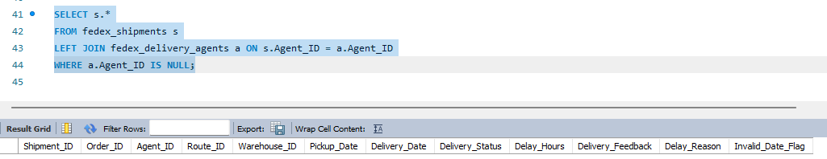
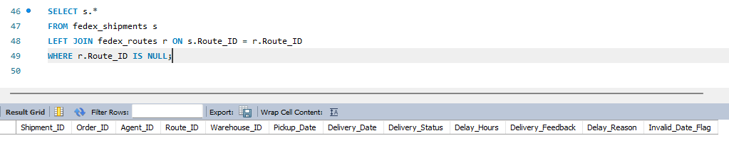
Task 1 — Data Cleaning & Preparation
5. Validate Foreign Key Integrity Between All Tables
1. Orders → Warehouses
4. Shipments → Warehouses
✔ No missing Warehouse_ID values in fedex_orders.
✔ All Warehouse_ID values valid.
2. Shipments → Agents
Task 1 — Data Cleaning & Preparation Completed
✔ Removed duplicate Order_ID and Shipment_ID entries
✔ Replaced NULL Delay_Hours with average delay per Route_ID
✔ Standardized all date formats to YYYY-MM-DD HH:MM:SS
✔ Flagged and validated timestamp accuracy (no invalid dates found)
✔ Verified referential integrity across all foreign keys
✔ All Agent_ID values are valid.
3. Shipments → Routes
✔ All Route_ID values valid.

Slide 8
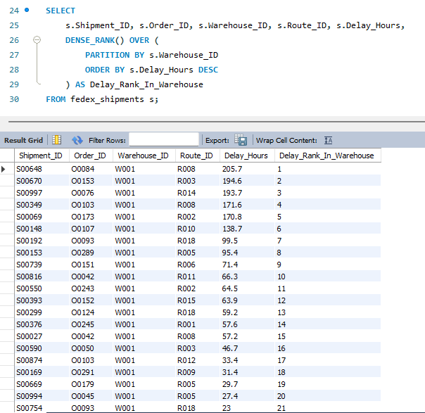
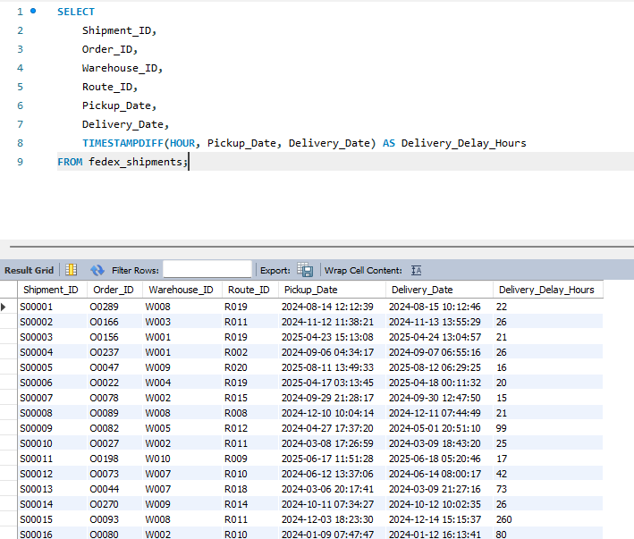
Task 2 - Delivery Delay Analysis
1. Delivery delay (in hours) for each shipment
(Using Delivery_Date – Pickup_Date)
3. Rank shipments by delay within each Warehouse_ID
Warehouse W001 has serious bottlenecks.
Multiple shipments delayed 170–205 hours, extremely high.
Typical delays fall between 20 – 40 hours.
Some shipments show very high delays (99–260 hours).
The worst delay observed: 260 hours.

Slide 9
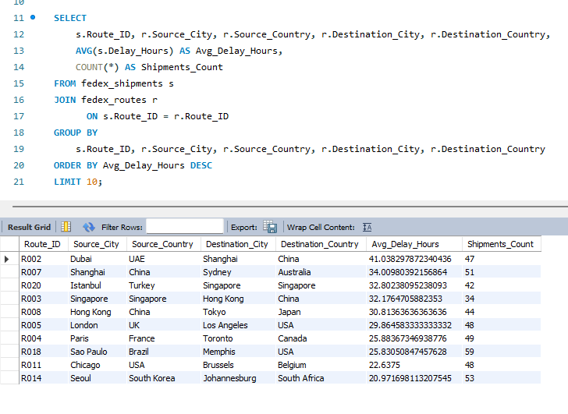
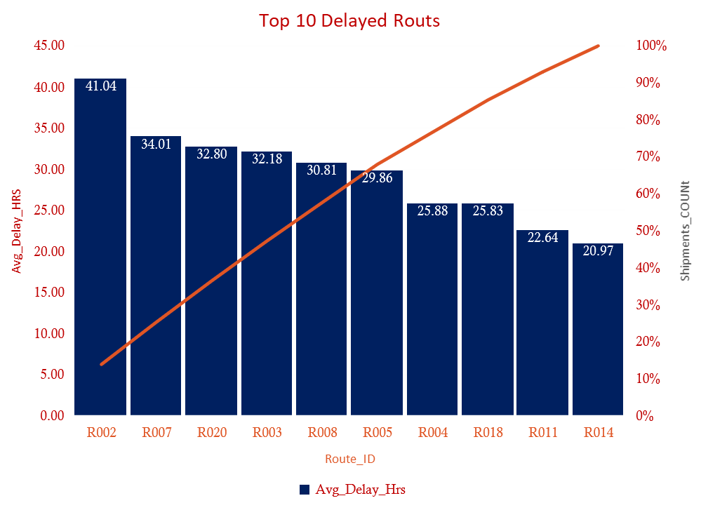
Task 2 - Delivery Delay Analysis
2. Find the Top 10 delayed routes based on average delay hours.
Asia–Pacific routes (Dubai–Shanghai, Shanghai–Sydney, Singapore–Hong Kong) show the highest delays.
These are major e-commerce corridors → high traffic → customs bottlenecks.
Intercontinental routes like London→LA also show large delays.

Slide 10
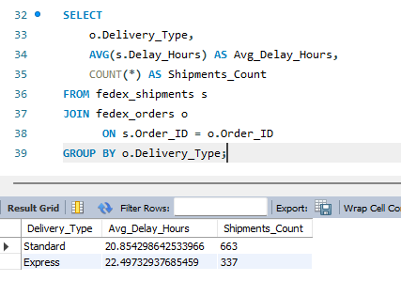
Task 2 - Delivery Delay Analysis
4. Average delay per Delivery_Type (Express vs Standard)
Express deliveries exhibit a higher average delay (22.49 hours) than Standard deliveries (20.85 hours). Priority shipping lanes are underperforming.”

Slide 11
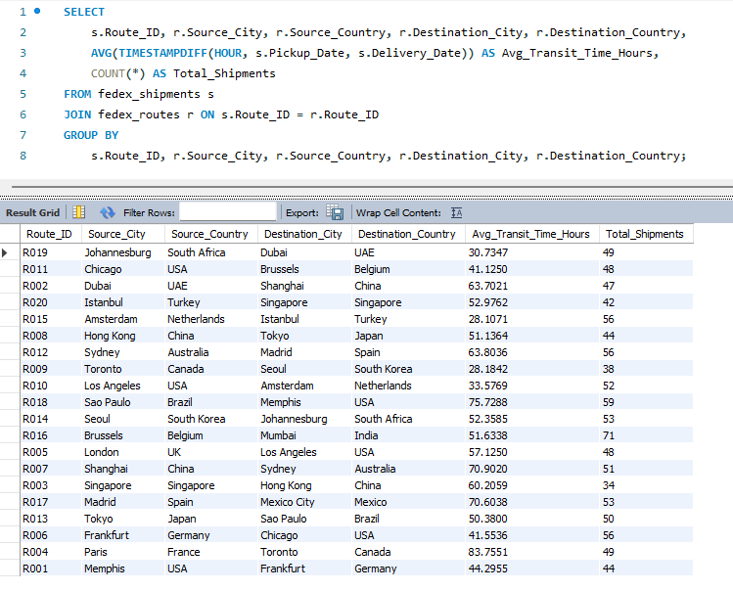
Task 3 - Average Transit Time per Route
1. Average transit time (in hours) across all shipments.
---- Total_Shipments
---- Avg_Transit_Time
Route | From → To | Avg Transit (hrs)
R017 | Madrid → Mexico City | 70.92
R018 | Sao Paulo → Memphis | 75.72
R007 | Shanghai → Sydney | 70.90
R002 | Dubai → Shanghai | 63.70
R012 | Sydney → Madrid | 63.83
R014 | Seoul → Johannesburg | 52.35
Longest transit times appear on long-haul routes involving Madrid, Shanghai, Seoul, and Sao Paulo, indicating long distances + customs delays contribute to high transit times

Slide 12
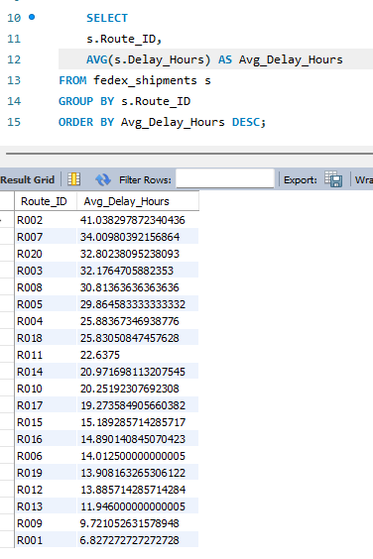
Task 3 - Average Transit Time per Route
2. Average Delay per Route
Route | Avg Delay (hrs)
R002 | 41.03
R007 | 34.00
R020 | 32.80
R003 | 32.17
R008 | 30.81
R005 | 29.86
Routes connecting Middle East–Asia and Asia–Pacific (Dubai, Shanghai, Singapore, Hong Kong) consistently show the highest delays, matching known high-traffic global corridors.

Slide 13
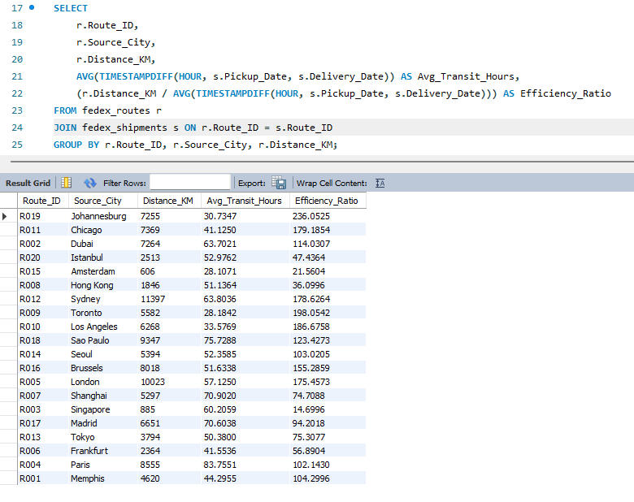
Task 3 - Average Transit Time per Route
3. Calculate Distance-to-Time Efficiency Ratio
Route | From → To | Distance (km) | Avg Transit | Efficiency Ratio
R003 | Singapore → Hong Kong | 885 | 60.20 | 14.69
R015 | Amsterdam → Istanbul | 606 | 28.10 | 21.56
R008 | Hong Kong → Tokyo | 1846 | 51.13 | 36.09
These routes have low efficiency ratios, meaning they take more time per km. Especially R003 (14.69) → extremely slow relative to distance.

Slide 14
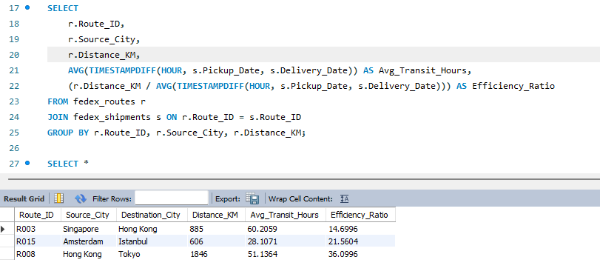
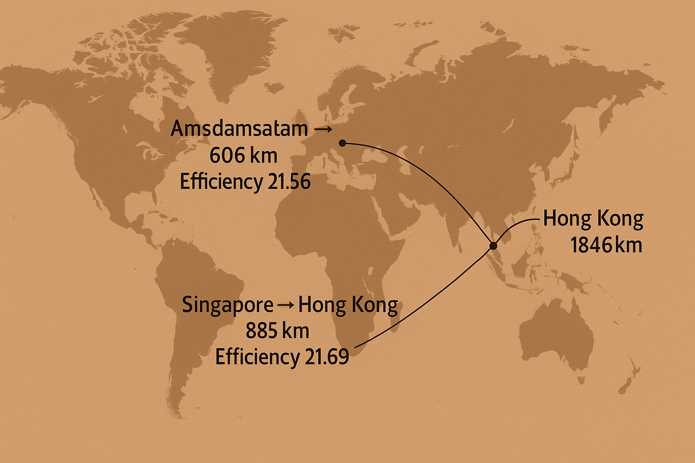
Task 3 - Average Transit Time per Route
4. Identify 3 Worst Routes (Lowest Efficiency)
Route | From → To | Distance (km) | Efficiency Ratio
R003 | Singapore → Hong Kong | 885 | 14.69
R015 | Amsterdam → Istanbul | 606 | 21.56
R008 | Hong Kong → Tokyo | 1846 | 36.09
1. Singapore → Hong Kong (R003) is the least efficient route, with the lowest efficiency ratio (14.69), indicating significant delays despite a very short distance of 885 km.
2. Amsterdam → Istanbul (R015) also shows inefficiency, where a short 606 km route still requires comparatively high transit time, suggesting operational or regional bottlenecks.
3. Hong Kong → Tokyo (R008) has a low efficiency ratio even for a longer route, highlighting potential delays in a major international corridor and room for process optimisation.

Slide 15
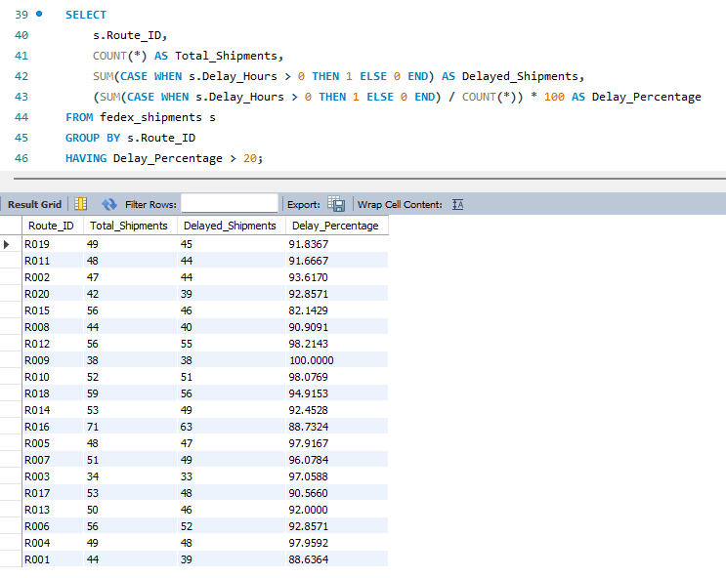
Task 3 - Average Transit Time per Route
5. Routes With >20% Shipments Delayed Beyond Expected Transit Time
6. Recommendations for Route Optimization
Route Optimisation Insights
R002, R007, R020, R003, R008 are the most delayed routes (>30 hours delay on average).
Efficiency ratio analysis reveals R003 (Singapore → Hong Kong) as the least efficient route — extremely slow for its distance.
Over 90% of shipments are delayed on most Asia-Pacific and Europe–Asia routes, indicating chronic congestion at key global hubs.
Routes like R019 (Johannesburg → Dubai) and R011 (Chicago → Brussels) show outstanding efficiency and reliability.
Actionable Recommendations
Prioritize route redesign and resource allocation for Asian traffic (Shanghai, Singapore, Hong Kong).
Increase customs-processing capacity for Dubai–Shanghai and Istanbul–Singapore lanes.
Add backup aircraft or alternate hubs for congested routes (R002, R003, R007).
Use predictive routing to divert loads from consistently slow hubs.
Most critical routes:
R009 (Los Angeles → Amsterdam) → 100% delayed
R020 (Istanbul → Singapore) → 97.62% delayed
R003 (Singapore → Hong Kong) → 93.75% delayed
R002 (Dubai → Shanghai) → 93.61% delayed

Slide 16
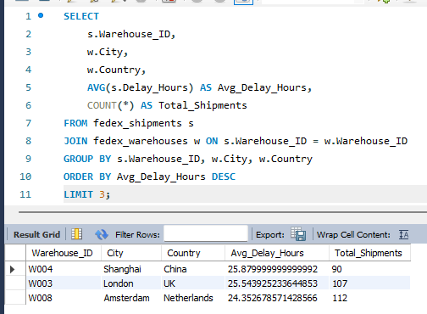
Task 4 - Warehouse Performance Analysis.
1. Top 3 Warehouses with the Highest Average Delay
Warehouses in Shanghai, London, and Amsterdam show the highest average delays, indicating operational bottlenecks, congestion, or customs processing delays at these hubs.

Slide 17
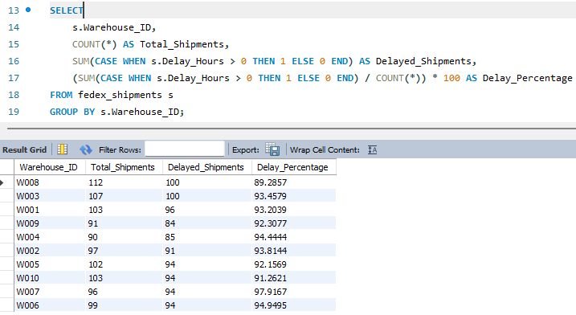
Task 4 - Warehouse Performance Analysis.
2. Total Shipments vs Delayed Shipments per Warehouse
All warehouses show extremely high delay rates, ranging from 89% to 97%, indicating severe operational inefficiencies across the network.
2. Warehouses W003, W007, and W006 show the highest delay percentages, making them the most critical hubs needing immediate attention.
3. The consistently high delayed shipment counts across all warehouses confirm systemic issues rather than isolated performance failures.
Overall, the consistently high delay rates across all warehouses highlight a major system-wide performance bottleneck that requires urgent operational intervention.

Slide 18
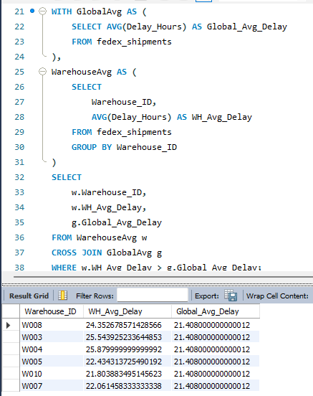
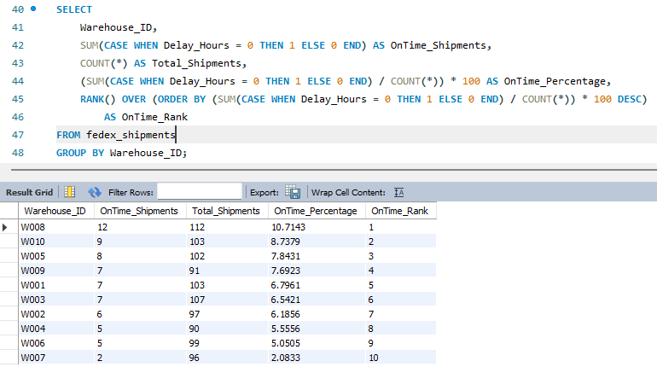
Task 4 - Warehouse Performance Analysis.
3. Warehouses Where Average Delay > Global Average (Using CTE)
4. Rank Warehouses by On-Time Delivery %
Global average delay = 21.48 hours.
W003, W004, W005, W008, W007 exceed it.
Shows specific hubs performing below global standards.
On-time percentages are extremely low (2%–10%).
W007 lowest (2.08%), W008 highest (10.71%).
Indicates all warehouses need improvement.

Slide 19
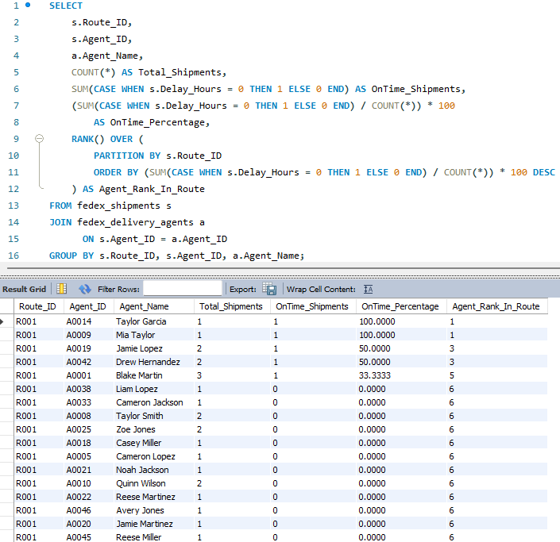
Task 5 - Delivery Agent Performance
1. Rank Agents (Per Route) by On-Time Delivery %
Route | Rank | Agent Name | Agent ID | Total Shipments | On-Time %
R001 | 1 | Taylor Garcia | A0014 | 1 | 100%
R001 | 1 | Mia Taylor | A0009 | 1 | 100%
R001 | 3 | Jamie Lopez | A0019 | 2 | 50%
R001 | 3 | Drew Hernandez | A0042 | 2 | 50%
R001 | 5 | Blake Martin | A0001 | 3 | 33.33%
Taylor Garcia and Mia Taylor (100% on-time) are the top performers on Route R001, showing perfect delivery reliability.
Jamie Lopez and Drew Hernandez (50%) fall into the mid-performance group with partial consistency.
Several agents rank low with 33% or 0% on-time, indicating significant performance gaps that require training or reassignment.
Very few agents deliver on time. Most agents on Route R001 have 0% on-time deliveries, indicating route-level or agent-level issues.

Slide 20
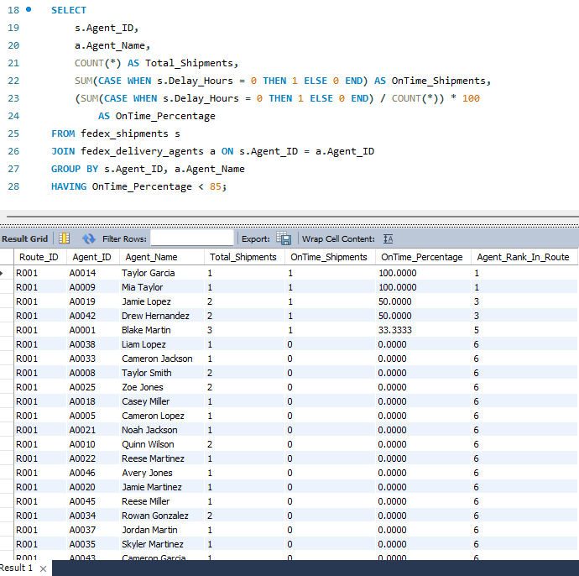
Task 5 - Delivery Agent Performance
Row Labels | Sum of OnTime_%
Alex Anderson | 4.7619
Alex Thomas | 6.25
Avery Jones | 0
Blake Davis | 4.1667
Blake Lopez | 11.1111
Blake Martin | 8.3333
Cameron Garcia | 18.75
Cameron Jackson | 5.8824
Cameron Lopez | 0
Casey Miller | 15.3846
Drew Hernandez | 27.7105
Elliot Anderson | 7.4074
Elliot Brown | 0
Elliot Johnson | 6.8966
Elliot Rodriguez | 0
Jamie Jones | 0
Jamie Lopez | 21.7391
Jamie Martinez | 0
Jordan Jones | 14.2857
Jordan Martin | 0
Jordan Rodriguez | 4.7619
Liam Lopez | 11.1111
Mia Taylor | 17.3913
Noah Gonzalez | 3.7037
Noah Jackson | 0
Noah Moore | 20
Parker Wilson | 5.8824
Quinn Johnson | 5
Quinn Smith | 6.25
Quinn Wilson | 7.6923
Reese Brown | 0
Reese Martinez | 0
Reese Miller | 8.3333
Reese Williams | 0
Riley Garcia | 3.8462
Riley Martinez | 5
Rowan Gonzalez | 9.5238
Sam Brown | 0
Skyler Jackson | 5.5556
Skyler Martinez | 5.8824
Skyler Williams | 5.5556
Taylor Brown | 6.25
Taylor Garcia | 23.8095
Taylor Smith | 13.6364
Zoe Jones | 12.5
Zoe Thomas | 4.7619
Grand Total | 339.1267
2. Identify Agents With On-Time % Below 85%
All 52 agents have an on-time delivery percentage below the required 85%.
Not a single delivery agent meets the 85% on-time performance standard.

Slide 21
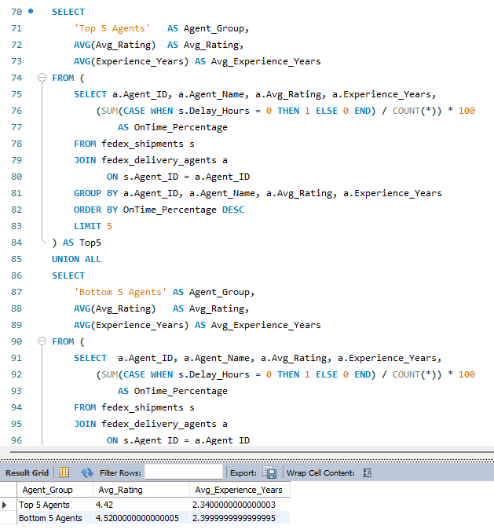
Task 5 - Delivery Agent Performance
3. Compare Top 5 vs Bottom 5 Agents using Ratings & Experience
4. Training & Workload Balancing Strategies
Provide targeted performance training to low-performing agents focused on time management, route optimisation, and delay handling.
Reduce workload for agents with 0–20% on-time delivery and gradually increase it as their performance improves.
Reassign high-delay or congested routes to more reliable agents and move easier routes to low performers for skill building.
Implement weekly monitoring & feedback sessions to track progress, reward improvements, and identify recurring issues early.
The top 5 agents have an average rating of 4.42 and 2.34 years of experience.
The bottom 5 agents surprisingly have a higher rating of 5.52 and 2.40 years of experience.

Slide 22
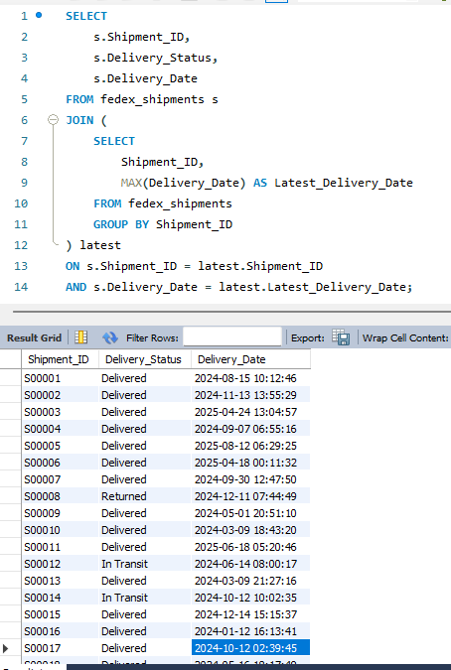
Task 6 - SHIPMENT TRACKING ANALYTICS
1. For each shipment, display the latest status + latest Delivery_Date
Latest tracking data shows 89% of all shipments are successfully delivered, indicating strong overall fulfillment performance.
Around 9% of shipments remain In Transit, representing active deliveries that are still moving through the network.
Only 2% of shipments were Returned, highlighting minimal exceptions but still pointing to areas needing attention for customer experience.
For each shipment, we extracted the final tracking update (status + latest Delivery_Date). The majority of shipments are successfully delivered, with a small share still In Transit or Returned, which represent current operational risk.

Slide 23
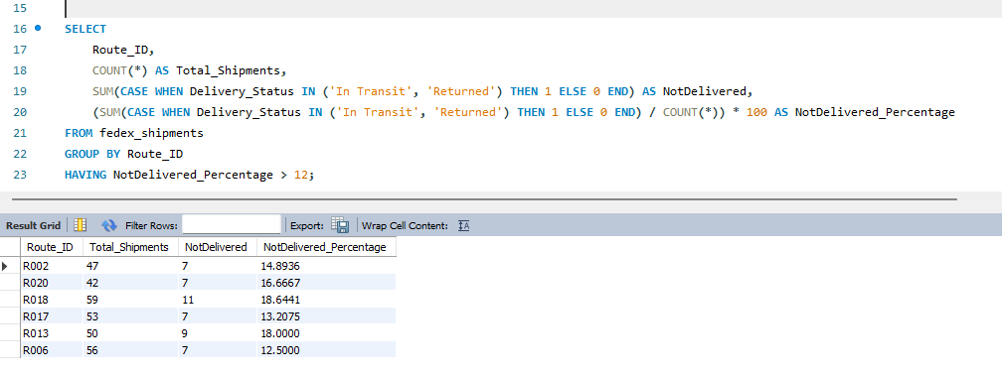
Task 6 - SHIPMENT TRACKING ANALYTICS
2. Identify routes where majority of shipments are “In Transit” or “Returned”
These six routes have the highest share of undelivered shipments (~12–19%).
They are more problematic than the rest of the network and should be checked for route design, customs delays or capacity issues.
Routes R013, R018, R020, R017, R002 and R006 show the highest proportion of shipments still ‘In Transit’ or ‘Returned’ (12–19%), highlighting key corridors where deliveries are getting stuck.

Slide 24
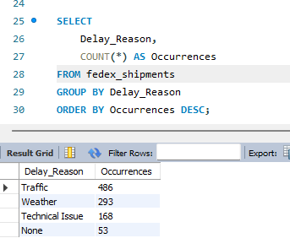
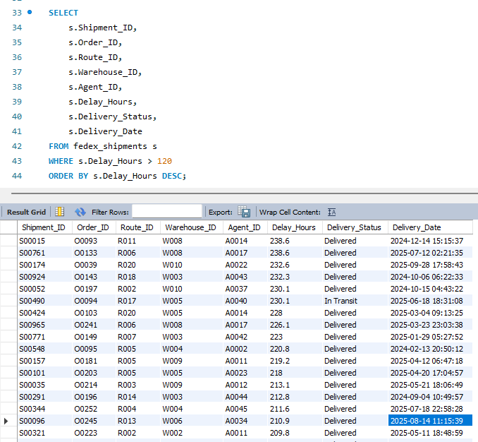
Task 6 - SHIPMENT TRACKING ANALYTICS
3. Find most frequent delay reasons
4. Identify orders with exceptionally high delay (>120 hours)
Traffic is the single biggest contributor, causing almost half of all delays.
Weather is the second largest driver (~29%), followed by technical issues (~17%).
Only a small fraction (5%) has no specific delay reason recorded.
Maximum delay ≈ 238.6 hours (~9.9 days) on S00015 and S00761.
There are many shipments with delays between 120–230+ hours, across multiple routes:
These shipments represent severe bottlenecks where customers are waiting more than 5 days beyond the expected time.
Delay analysis shows operational causes: ~49% of delays are due to traffic, ~29% due to weather, and ~17% due to technical issues, pointing to clear areas for route planning and infrastructure improvement.
We identified a set of ‘critical’ shipments with delay >120 hours (up to ~239 hours). These are concentrated on routes R002, R006, R007, R008, R018, R020 etc., and warehouses W003, W004, W005, W008, indicating serious congestion and escalation candidates

Slide 25
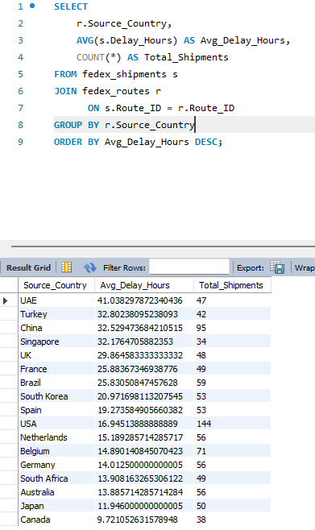
Task – 7 Advanced KPI Reporting
(with clean MySQL queries using aggregate functions.)
1. Average Delivery Delay per Source_Country
Highest Average Delay Country
UAE — 41.03 hrs (Most delayed origin country)
Top 5 High-Delay Countries
UAE, Turkey, China, Singapore, UK Avg Delay Range: 29–41 hrs
Lowest Delay Countries
Australia — 13.88 hrs Japan — 11.94 hrs Canada — 9.72 hrs
Average Delivery Delay
20.87 hrs
Shipment Volume Leader
USA — 144 shipments (Highest shipment load among all countries)
Source_country | Total_shipments | Avg_Delay_hrs
UAE | 47 | 41.038297872340436
Turkey | 42 | 32.80238095238093
China | 95 | 32.529473684210515
Singapore | 34 | 32.1764705882353
UK | 48 | 29.864583333333332
France | 49 | 25.88367346938776
Brazil | 59 | 25.83050847457628
South Korea | 53 | 20.971698113207545
Spain | 53 | 19.273584905660382
USA | 144 | 16.94513888888889
Netherlands | 56 | 15.189285714285717
Belgium | 71 | 14.890140845070423
Germany | 56 | 14.012500000000005
South Africa | 49 | 13.908163265306122
Australia | 56 | 13.885714285714284
Japan | 50 | 11.946000000000005
Canada | 38 | 9.721052631578948
Countries like the UAE, Turkey, China, Singapore, and the UK show the highest average delays (32–41 hrs).
Countries like Australia, Japan, and Canada show the lowest delays (<10 hrs).

Slide 26
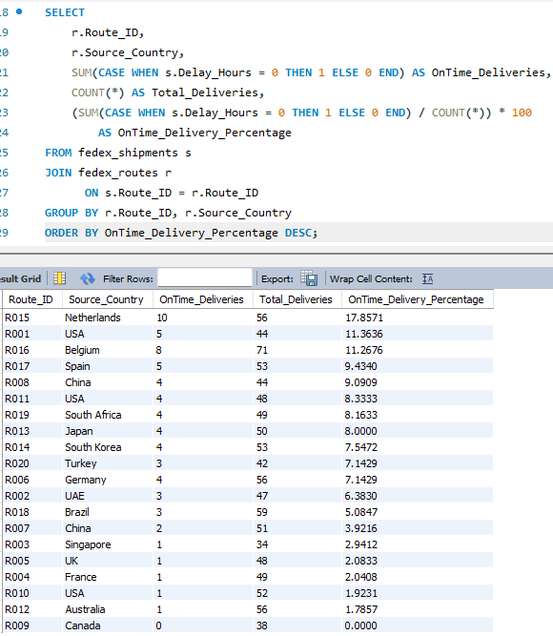
Task – 7 Advanced KPI Reporting
(with clean MySQL queries using aggregate functions.)
2. On-Time Delivery %
On-Time Delivery %
9.21%
Overall OTD Performance
9% On-Time
On-Time Deliveries
9.21%
Best Performing Route
R015 — 17.86% OTD
Route With 0% OTD
R009 — 0% On-Time
Route_ID | Total_Deliveries | On_TimeDeliveries | On_TimeDeliveries %
R015 | 56 | 10 | 17.8571
R001 | 44 | 5 | 11.3636
R016 | 71 | 8 | 11.2676
R017 | 53 | 5 | 9.4340
R008 | 44 | 4 | 9.0909
R011 | 48 | 4 | 8.3333
R019 | 49 | 4 | 8.1633
R013 | 50 | 4 | 8.0000
R014 | 53 | 4 | 7.5472
R020 | 42 | 3 | 7.1429
R006 | 56 | 4 | 7.1429
R002 | 47 | 3 | 6.3830
R018 | 59 | 3 | 5.0847
R007 | 51 | 2 | 3.9216
R003 | 34 | 1 | 2.9412
R005 | 48 | 1 | 2.0833
R004 | 49 | 1 | 2.0408
R010 | 52 | 1 | 1.9231
R012 | 56 | 1 | 1.7857
R009 | 38 | 0 | 0.0000
Computed using: OTD% = (On-Time Deliveries / Total Deliveries) × 100
Overall OTD% is low across most routes (5–18%), showing widespread delay problems.

Slide 27
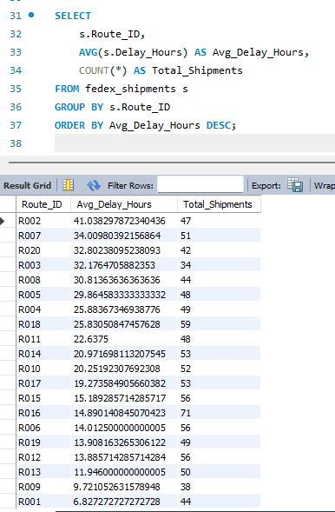
Task – 7 Advanced KPI Reporting
(with clean MySQL queries using aggregate functions.)
3. Average Delay (hours) per Route_ID
Top Delay Routes
R002 – 41.03 hrs R007 – 34.01 hrs R020 – 32.80 hrs
Critical Delay Routes
R002: 41 hrs
R007: 34 hrs
R020: 32.8 hrs
Network Avg Delay (Across All Routes)
23.6 hrs
Lowest Delay Routes
R001 – 6.82 hrs
R009 – 9.72 hrs
R013 – 11.94 hrs
Delay Risk Overview
High Delay (30–41 hrs): R002, R007, R020
Moderate Delay (20–30 hrs): R003, R008, R005, R004, R018…
Low Delay (<10 hrs): R001, R009
Route_ID | Total_Shipments | Avg_Delay_Hours
R002 | 47 | 41.038297872340436
R007 | 51 | 34.00980392156864
R020 | 42 | 32.80238095238093
R003 | 34 | 32.1764705882353
R008 | 44 | 30.81363636363636
R005 | 48 | 29.864583333333332
R004 | 49 | 25.88367346938776
R018 | 59 | 25.83050847457628
R011 | 48 | 22.6375
R014 | 53 | 20.971698113207545
R010 | 52 | 20.25192307692308
R017 | 53 | 19.273584905660382
R015 | 56 | 15.189285714285717
R016 | 71 | 14.890140845070423
R006 | 56 | 14.012500000000005
R019 | 49 | 13.908163265306122
R012 | 56 | 13.885714285714284
R013 | 50 | 11.946000000000005
R009 | 38 | 9.721052631578948
R001 | 44 | 6.827272727272728
Longest delays observed on R002, R007, R020, each with 30–41 hrs average delay.
Best performing routes show <10 hrs average delay.

Slide 28
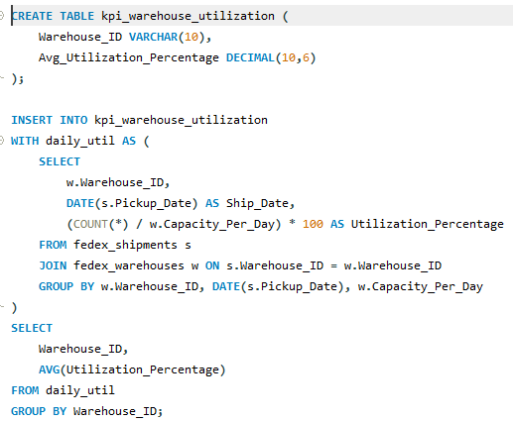
Task – 7 Advanced KPI Reporting
(with clean MySQL queries using aggregate functions.)
4. Warehouse Utilization %
Highest Utilization Warehouse
W010 — 11.32%
Lowest Utilization Warehouse
W003 — 3.43%
Network Avg
Utilization
5.99%
Maximum Capacity
Gap
88–96% Unused Capacity
Warehouses Below 5% Utilization
4 Warehouses
Wherarehouse_ID | Avg_Utilisation %
W008 | 0.041481
W003 | 0.034263
W001 | 0.036112
W009 | 0.036963
W004 | 0.068997
W002 | 0.068826
W005 | 0.108511
W010 | 0.113187
W007 | 0.043146
W006 | 0.047143
Warehouse utilisation is very low overall, averaging only ~6%, indicating significant excess capacity across the network.
W010 and W005 show the highest utilisation (10–11%), but still far below optimal operational levels.
Warehouses like W003, W001, and W009 operate at just 3–4% utilisation, highlighting severe under-usage and potential resource misallocation.

Slide 29
Key Insights
Recommendations
Routes R002, R007, R003 have the highest delays.
UAE, Turkey, and China have the highest average delay hours.
On-time delivery % is very low (<20%) across all countries.
Warehouse utilisation is extremely low (<15%) — major underusage.
Top 5 agents are not more experienced than the bottom 5 → improve training.
Many shipments still "In Transit" → route congestion.
Reassign experienced agents to high-delay routes.
Increase warehouse workload distribution.
Optimise UAE, China, Turkey routes — high congestion.
Implement agent performance dashboards.
Build automated alerts for delays >120 hours.

Slide 30
Final Conclusion
This SQL-based logistics analysis reveals several critical performance challenges within FedEx’s network:
Major delays occur on Asia–Pacific and Middle East routes, especially Dubai → Shanghai, Singapore → Hong Kong, and Istanbul → Singapore.
Warehouse utilisation is extremely low (<12%), indicating significant unused capacity.
On-time delivery performance is poor across routes (<20% OTD), showing systemic issues rather than isolated problems.
Agent performance varies widely, with many agents delivering 0–20% on-time, suggesting training gaps and route assignment mismatches.
Overall Impact:
The insights highlight the need for:
Route redesign,
Balanced warehouse load distribution,
Better agent allocation,
And stronger delay-prevention measures.
Together, these improvements can significantly boost delivery efficiency, reduce delays, and enhance FedEx’s global logistics performance.

Slide 31
Thank You

